Slide 1

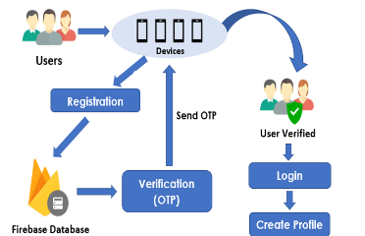

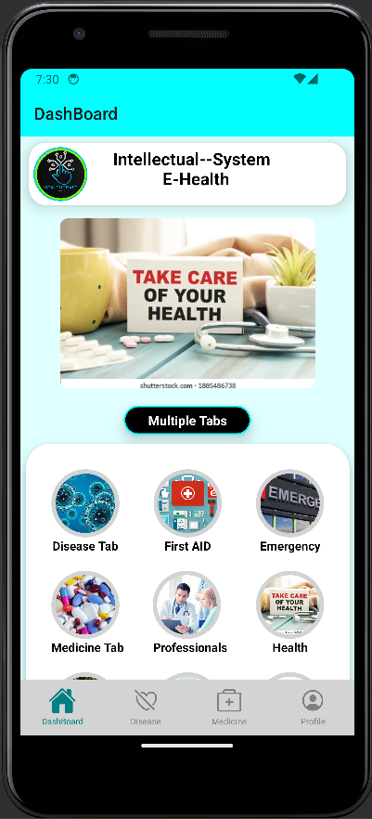
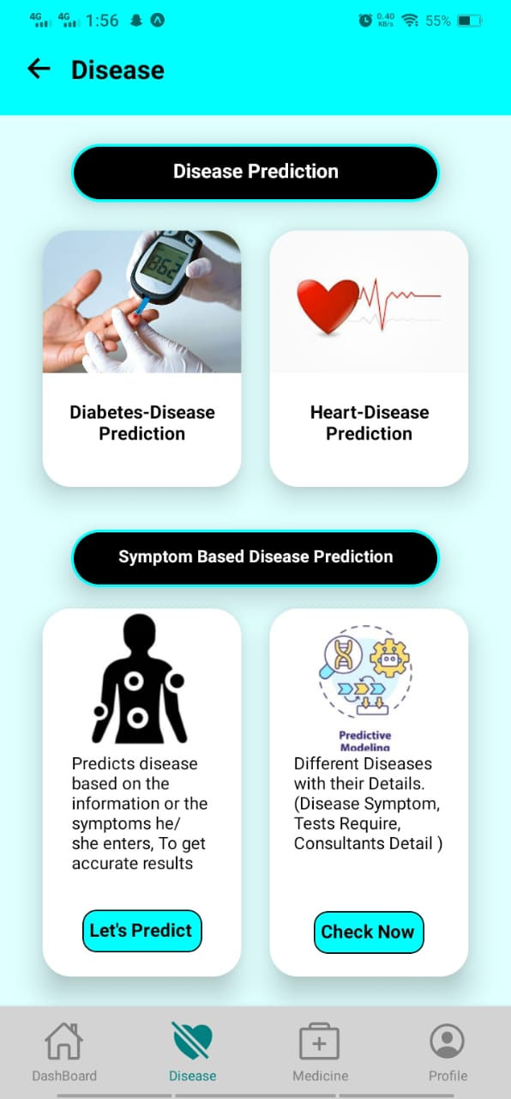

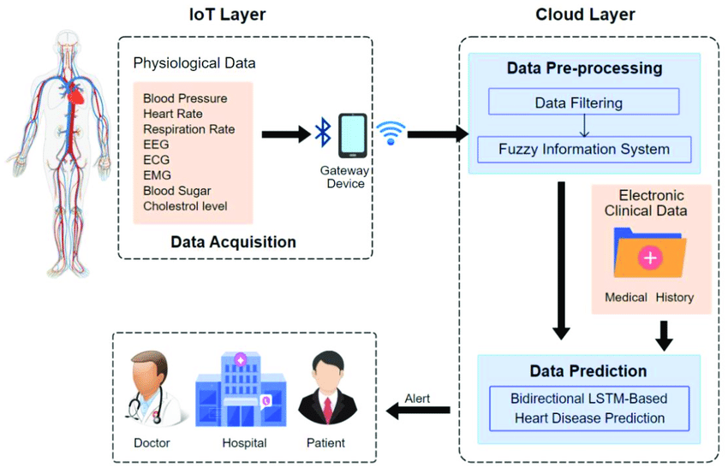
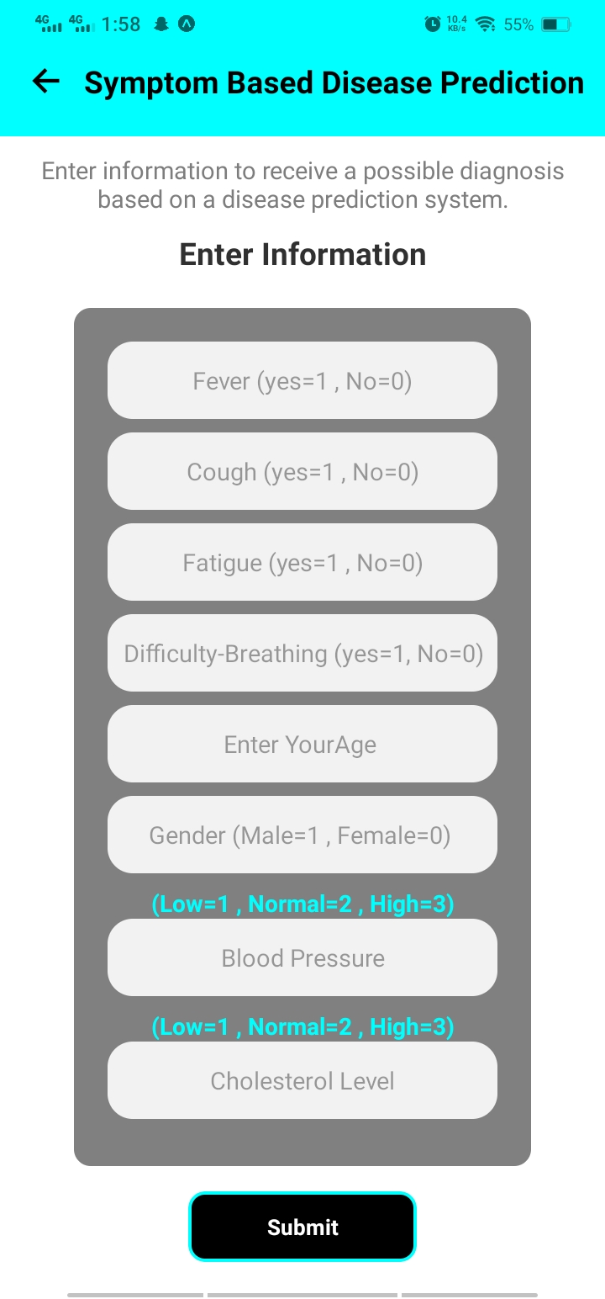
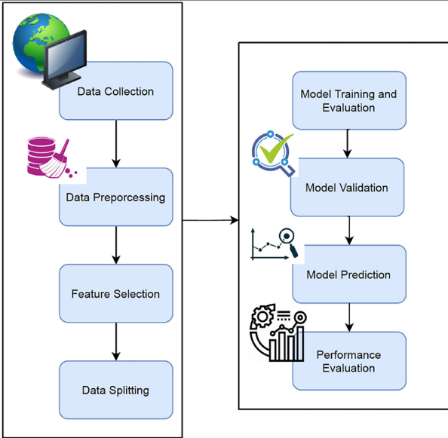
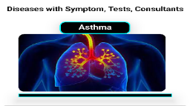
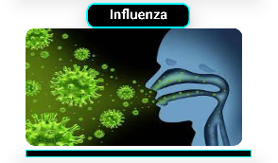
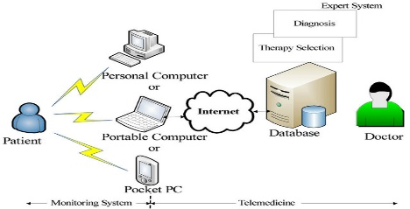

Intellectual System For E-Health ^{Final Year Project (2020-2024)} ^{Department of Computer Science} COMSATS University Islamabad, Attock Campus
Introduction
Disease-Prediction Using Machine Learning is to predict the accurate disease of the patient using all their general information the symptoms. it's a companion dedicated to ensuring that you have the tools and information you need to live a healthier, more informed life.
Motivations
Reduce the number of hospital visits.
Reduce number of preventable deaths.
Improve health outcomes of individuals.
Reduce the burden of healthcare costs.
Promote healthy behaviors and lifestyle.
Develop innovative healthcare solutions.
Provide support for people with chronic diseases. Also Improve patient provider communication.
System Background
There are some problems with the existing systems which are identified below:
Existing healthcare services are often limited in accessibility and lack personalization.
Traditional healthcare approaches focus on reactive treatment rather than proactive prevention.
Fragmented healthcare data and limited patient engagement hinder effective healthcare management.
Architecture
Results
Conclusion
The system has the potential to significantly improve the lives of its users by providing them with convenient and personalized access to a variety of healthcare services.
The symptom-based disease prediction model, diabetes disease prediction model, and heart disease prediction model can help users identify potential health problems early on and get the care they need.
The app also provides users with information on diet, health, exercise, first aid, emergencies, and medicine tabs. This information can help users make informed decisions about their health and well-being.
Login
User Application
On Disease Tab user give Symptom and Model will predict Disease
Login
Dashboard where multiple Screen’s
Devices
Registration
DashBoard
Verification
Medicine’s
Disease
User Symptom’s
Home
Different Tab’s
Emergency
First-Aid
Health
Diet
Exercise
Future Directions
The system is committed to boosting accuracy, adding features, and broadening coverage.
The app's prediction models will be enhanced through machine learning and data collection.
New features will include a personalized health plan, medication reminders, and virtual doctor consultations.
The app will continuously utilize machine learning and AI to address the evolving needs of its users.
Prediction
Your Symptoms indicating
(Asthma-Disease) & Prediction is Positive
Ok
Symptoms: wheezing, Breathlessness, Tight Chest, Coughing.
Tests: CT Scan, Blood Test.
Consultants: Dermatologist.
Symptoms: Fever, Sore Throat, Stuffy-Nose, Fatigue, Body Aches.
Tests: RT-PCR & Viral Culture Test.
Consultants: General Physician.
Members
Name: Shahid iqbal Reg No: SP20-BCS-008
Email: Shahidiqbalofficial.is@gmail.com
Supervisor Co-Supervisor
Mr. Umar Zia Mr. Waseem khan
Objectives
Early identification of potential health risks
Empowered individuals taking charge of their well-being
Prepared for any health situation
Continuous improvement and expansion
Personalized & convenient health management services

